Slide 1
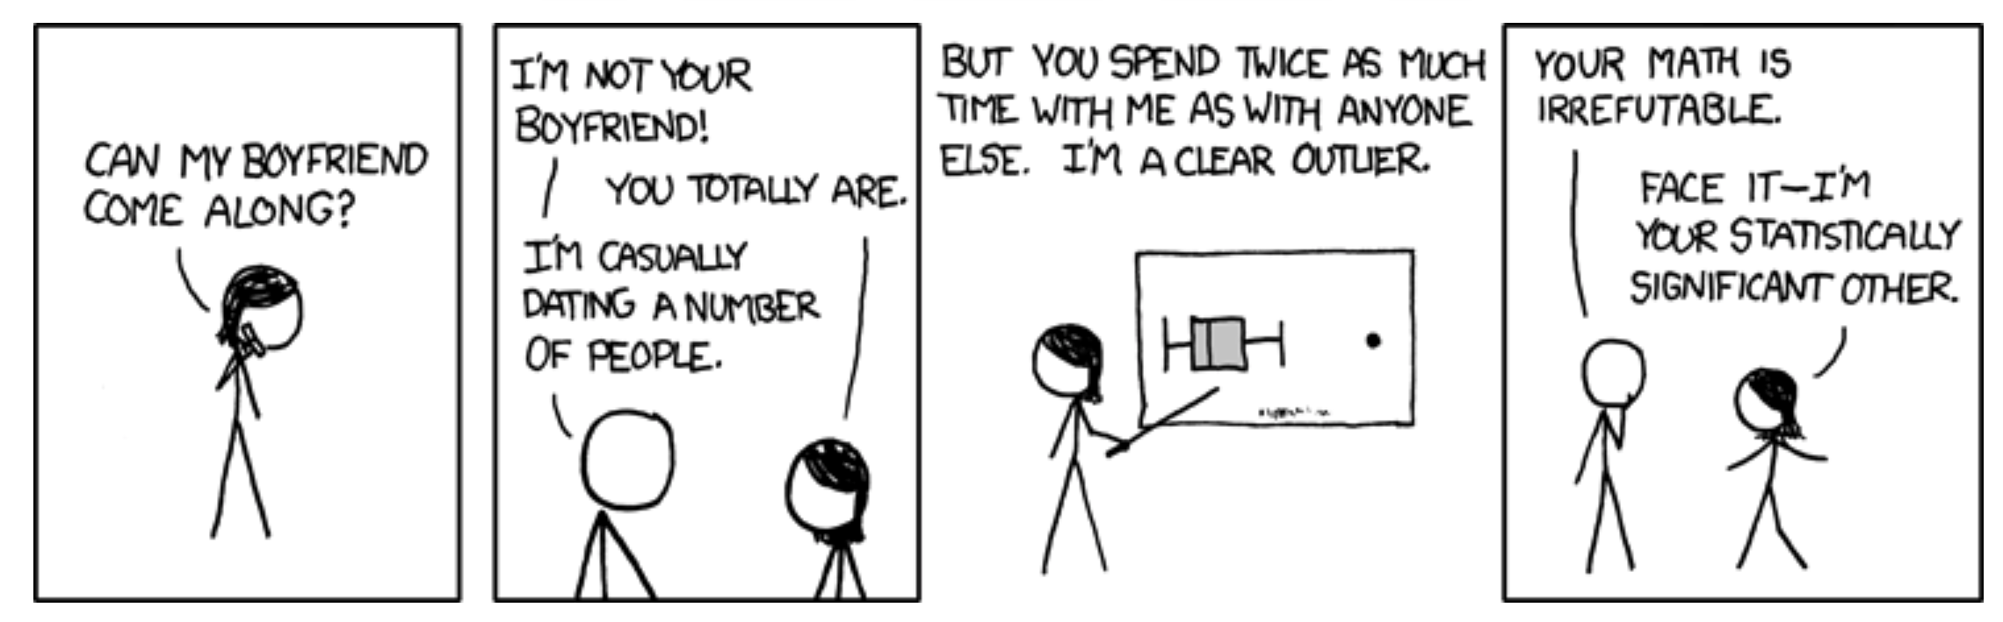
Binary Response Variables, Random vs Fixed Effects, and Outliers Biology 683 Lecture GLM2 Heath Blackmon

Slide 2
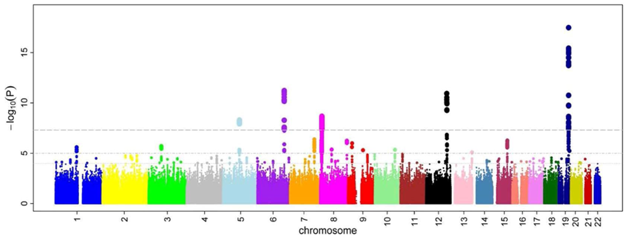
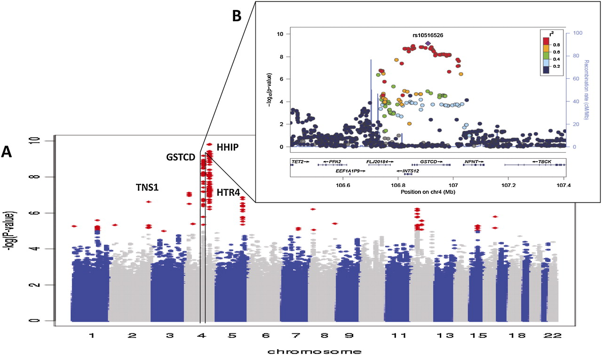
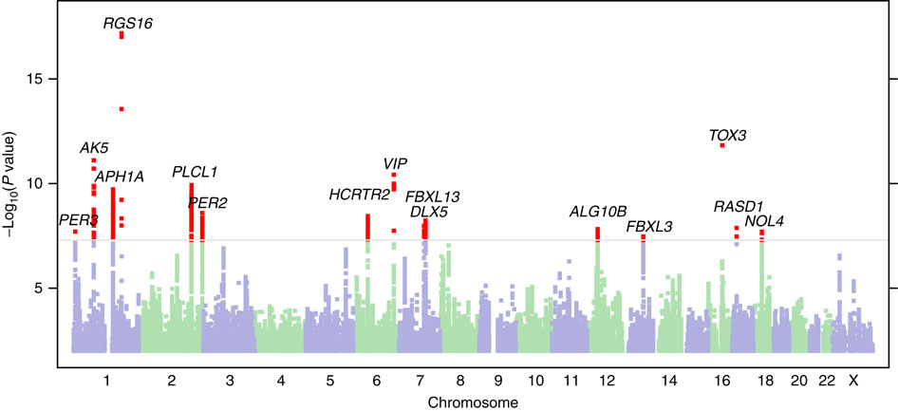
GWAS

Slide 3
GWAS
GWAS: Genome wide association study.
The goal of GWAS is to determine what genes have alleles that are responsible for a trait of interest. The trait can be any measurable trait in any organism that you wish to study. For instance, a disease in humans, an economically important trait of a crop or domestic animal, an adaptation like a certain color pattern in birds, etc.

Slide 4
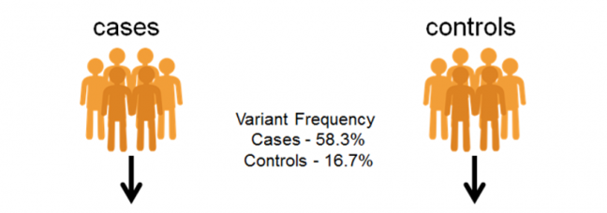
GWAS – Discrete condition (often disease)
>case 1
CATACTACTACTGAACGTTTGCTCCTGCtactatctctctctctctctctttctctctctctctctCATGC >case 2
AGTTGACTACTGCATACTCGTGCTAGCTGACTGTCGTACGTACGTAGCTAGTGATCGATCGATGCTAGCTA>case 3
CATACTACTACTGAACGTTTGCTCCTGCtactatctctctctctctctctttctctctctctctctCATGC >control 1
AGTTGACTACTGCATACTCGTGCTAGCTGACTGTCGTACGTACGTAGCTAGTGATCGATCGATGCTAGCTA>control 2
CATACTACTACTGAACGTTTGCTCCTGCtactatctctctctctctctctttctctctctctctctCATGC >control 3
AGTTGACTACTGCATACTCGTGCTAGCTGACTGTCGTACGTACGTAGCTAGTGATCGATCGATGCTAGCTA

Slide 5
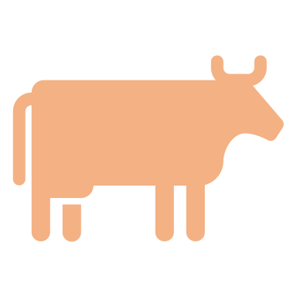



GWAS – Continuous trait
>sample 1
CATACTACTACTGAACGTTTGCTCCTGCtactatctctctctctctctctttctctctctctctctCATGC >sample 2
AGTTGACTACTGCATACTCGTGCTAGCTGACTGTCGTACGTACGTAGCTAGTGATCGATCGATGCTAGCTA>sample 3
CATACTACTACTGAACGTTTGCTCCTGCtactatctctctctctctctctttctctctctctctctCATGC >sample 4
AGTTGACTACTGCATACTCGTGCTAGCTGACTGTCGTACGTACGTAGCTAGTGATCGATCGATGCTAGCTA>sample 5
CATACTACTACTGAACGTTTGCTCCTGCtactatctctctctctctctctttctctctctctctctCATGC >sample 6
AGTTGACTACTGCATACTCGTGCTAGCTGACTGTCGTACGTACGTAGCTAGTGATCGATCGATGCTAGCTA

Slide 6
GWAS – Continuous trait
AGTTGACTACTGCATACTCGT
AGTTGACTACTGCATACTCGT
AGTTGACTACTGCATACTCGT
AGTTGACTACTGCATACTCGT
TGTTGACTACTGCATACTCGT
AGTTGACTACTGCATACTCGT
TGTTGACTACTGCATACTCGT
TGTTGACTACTGCATACTCGT
AGTTGACTACTGCATACTCGT
TGTTGACTACTGCATACTCGT
TGTTGACTACTGCATACTCGT
TGTTGACTACTGCATACTCGT
coat color
Not significant
AA AT TT

Slide 7
GWAS – Continuous trait
AGTTGACTACTGCATACTCGT
AGTTGACTACTGCATACTCGT
AGTTGACTACTGCATACTCGT
AGTAGACTACTGCATACTCGT
TGTAGACTACTGCATACTCGT
AGTAGACTACTGCATACTCGT
TGTAGACTACTGCATACTCGT
TGTTGACTACTGCATACTCGT
AGTAGACTACTGCATACTCGT
TGTAGACTACTGCATACTCGT
TGTTGACTACTGCATACTCGT
TGTTGACTACTGCATACTCGT
coat color
Highly significant!
AA AT TT

Slide 8
GWAS - Problems
What is the problem with doing this across the whole genome?
Multiple tests lead to more false positives!
require a higher level of significance 5x10⁻⁸
only look at the very most significant
lots of more complicated approaches too!
What is one of the most basic requirements of almost all statistical tests?
Tests normally assume independence of the data points!
Samples from a population will be related to each other due to ancestry (trees!)
DNA sequencing is not done equally in all groups of people (western samples are usually over represented

Slide 9
GWAS - Problems
What is epistasis?
It is the case where the impact of a genotype at one locus depend on the genotype at another locus!
To find this type of effect you would need to look at all pairs of genotypes. How many tests would we need to do then?
About 6 orders of magnitude more tests would be required.
Humans have around 4,000,000 sites that are variable like this which equates to 7,999,998,000,000
GG
GT
TT
AA AT TT

Slide 10
GWAS - Problems
What about the environment?
Many diseases have a strong environmental component (heart disease, diabetes, cancer, etc.)
If these are left out of the study often what is discovered is actually genetic variation that happens to coincide with environmental factors?
If a disease is more common in Europeans than Africans or Asians but it is because of a lifestyle characteristic any genetic variation that is common in Europeans but rare in Africans and Asians could appear associated with the disease.

Slide 11
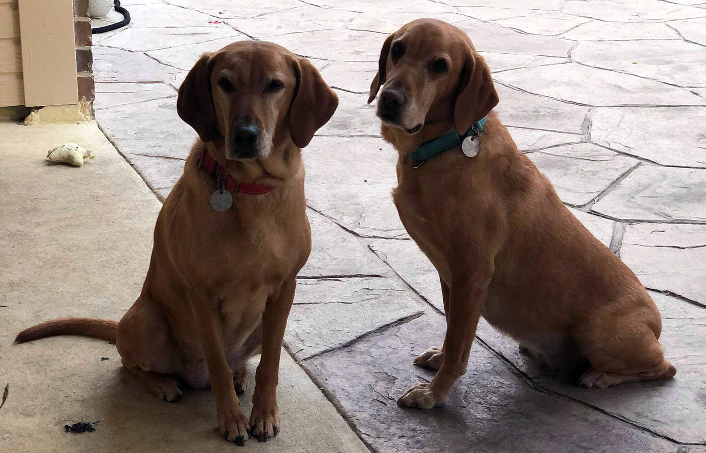
Applications and benefits of GWAS
Widely used in agriculture and domestication. For instance, you can do a GWAS on wild strains of rice (which have lots of variation in things we care about like grain size, growing time, etc.) This GWAS can tell you what variants at what locations in the genome should be introgressed into domestic varieties in hopes of introducing favorable traits.
Widely used in medicine to identify the genes responsible for disease. This is
often the first step necessary in being able to create an animal model for a
disease that will then allow researchers to study the disease and develop
pharmaceutical interventions.
Many diseases have multiple different underlying genetic causes and treatments
that are available may only work on some forms of the diseases. Thanks to GWAS studies we now know what these different causal genes are. Now patients can be genotyped at these causative loci and medication can be tailored to their version of the disease. (precision or personalized medicine)
Applied in a more limited fashion to inform patients of risk that they will develop more severe versions of a disease. For instance depending on your genotype at a gene you may choose a more aggressive form of treatment.

Slide 12
Complex Disease / Complex Phenotypes
Many diseases are what we call complex diseases. There is no one gene responsible for the disease. Instead the disease can manifest due to variations in 10 or 100s of different genes in the genome acting in concert with the environment. GWAS is less insightful (though still important) for diseases like this.
Schizophrenia: Not really a clearly delineated disease like say COVID, type 1 diabetes, or cystic fibrosis. Instead it is a constellation of symptoms that individuals exhibit to varying degrees.
From studies of multiple generations of families we know that 20-30% of risk is inherited (genetic). The other 70-80% of your risk of developing the disease is environmental and is poorly understood. Massive GWAS studies with 1000s of individuals have studied the genetic component. These studies have identified more than 100 different loci in the genome that seem to have some predictive power. However, these variations are associated with an increase in risk and there are many people who carry many alleles that increase risk but that never develop the disease.

Slide 13
Mixed models
Mixed models are models that include fixed and and random effects.
Fixed effects can be repeated by other researchers. These are the variables that you are interested in studying.
Random effects are usually nuisance parameters. These are variables that other researchers cannot replicate and you are not interested in inferring anything about them.

Slide 14
Mixed models
Fixed effects are the variables whose impact we wish to determine
Characteristics of the media or habitat
Experimental treatments
Age groups
Time points
Mutant genotypes
Conclusions that you reach are only applicable to the groups or treatments you include in the study

Slide 15
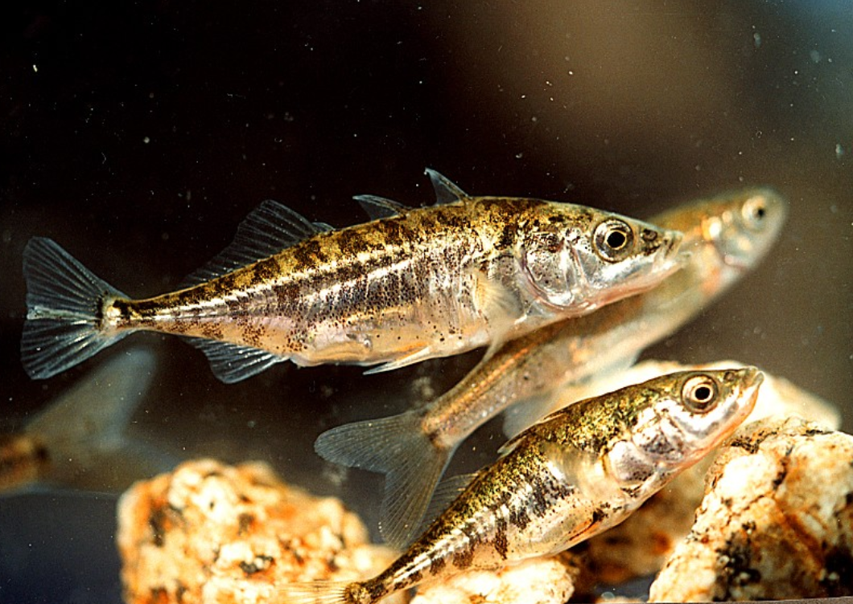
Example of fixed effects
Reciprocal relocation experiment to investigate how genotype and habitat interact to determine the fitness of stickleback fish (Rundle 2002).
 |  | Source habitat
 |  | Shallow | Deep
Test habitat | Shallow | 12 fish | 11 fish
 | Deep | 7 fish | 11 fish

Slide 16
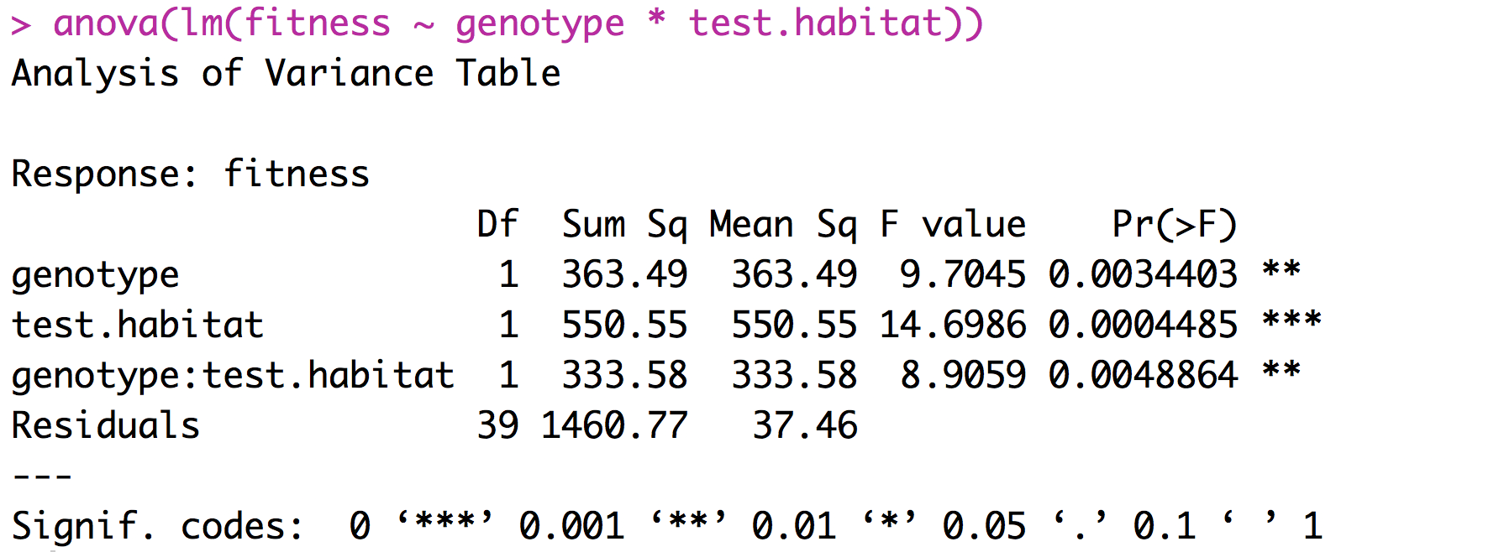
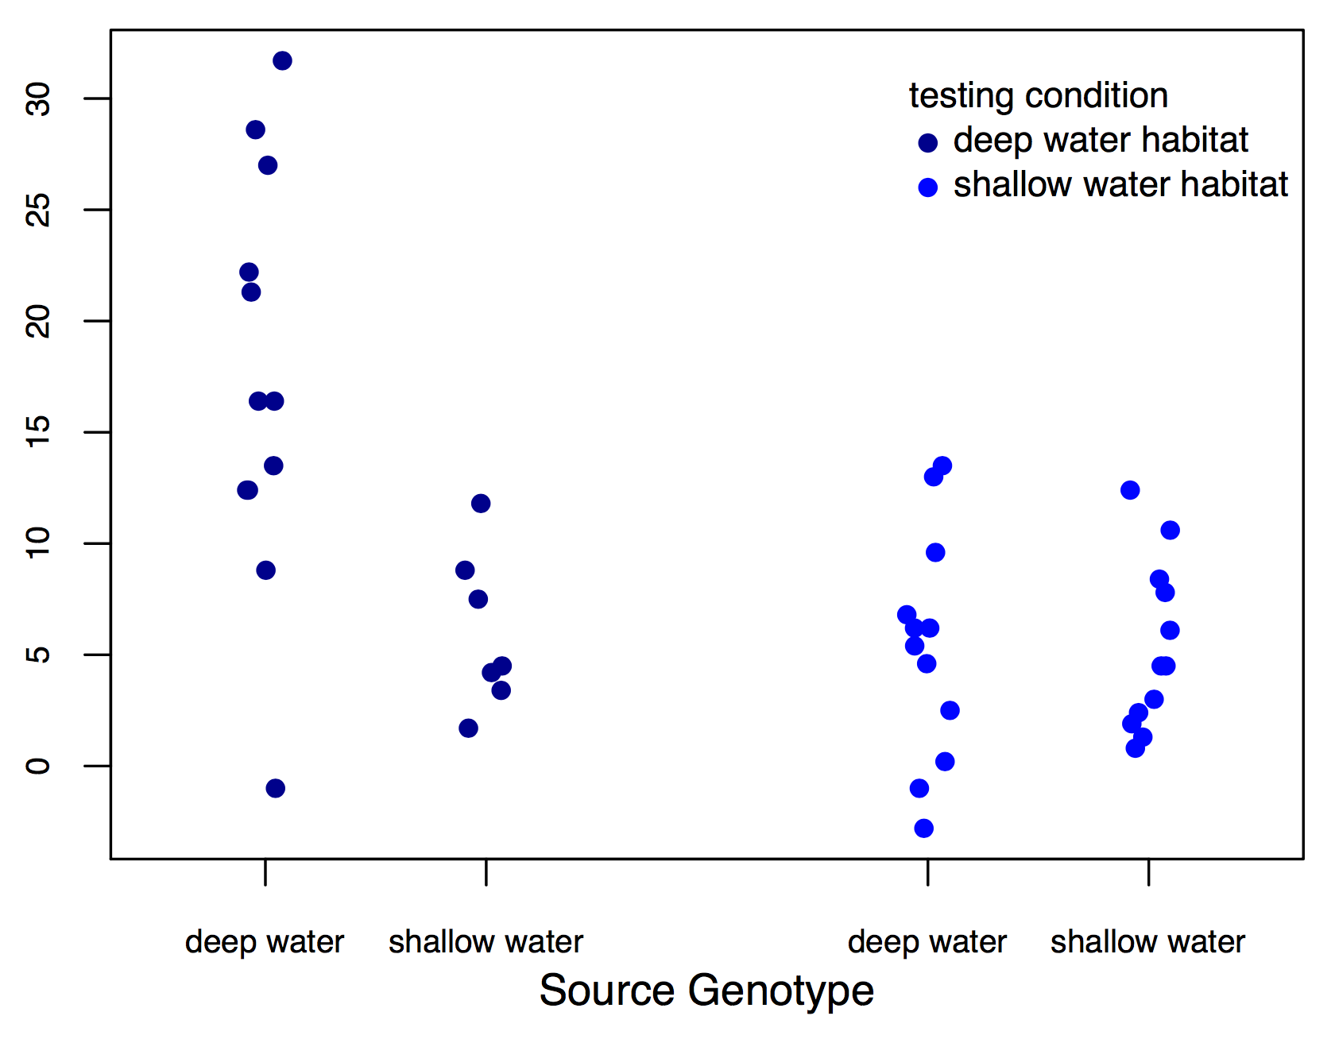
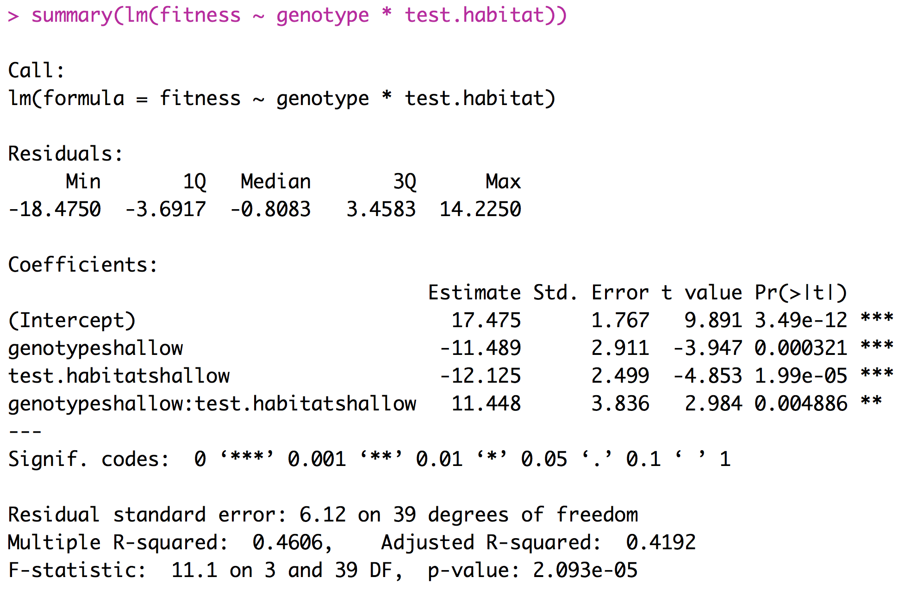
Example of fixed effects (two factor ANOVA)
fitness

Slide 17
Interpreting Coefficients

Slide 18
What is a random effect
These are randomly sampled categories of a variable that represent groups of individual measurements. Usually random effects are not repeatable.
Study sites
Environmental chambers
Families made up of siblings
Measurements within individuals
Conclusions that you reach are applicable only to the sample being studied.

Slide 19
What is a random effect
Sometimes random effects are a nuisance
Field sites
Environmental chambers
Field plots
Repeated measures
Occasionally random effects are of great interest
Families - Heritability
Individuals – Breeding value

Slide 20
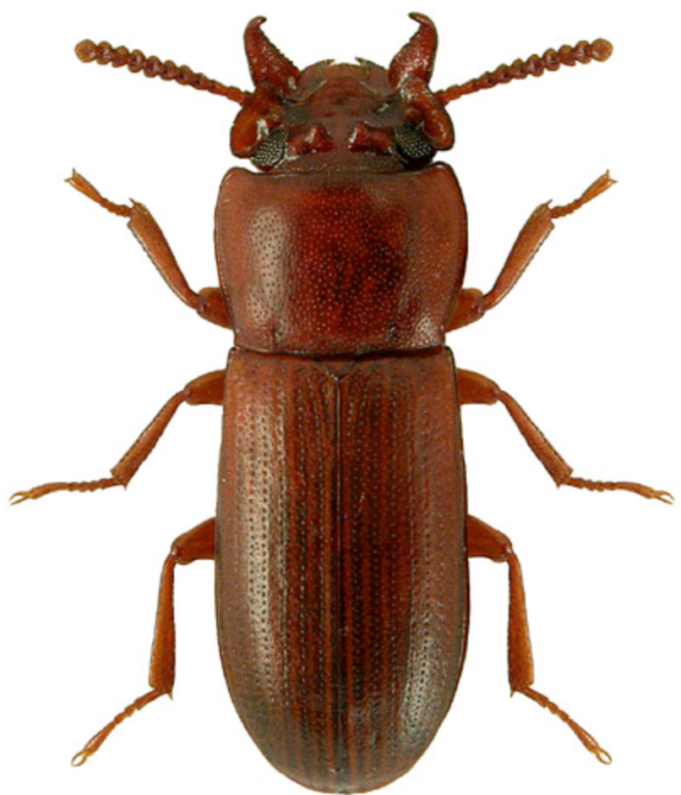
Example of random effects
Impact of selective regime on horn size. Measure both the left and right horn in 25 beetles from two different selective regimes.
Horn size | Beetle | Selective regime
256 276 321 321 423 401 381 409 | 1 1 2 2 3 3 4 4 | High High High High Low Low Low Low

Slide 21
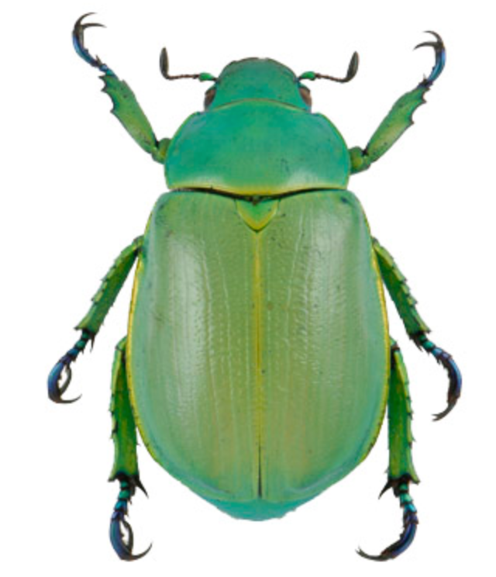
Example of random effects
Identifying the predictors for the presence or absence of Chrysina beetles.
Number collected | oak | juniper | site | date | trip
8 2 1 5 4 6 0 7 | 1 1 0 0 1 1 1 1 | 0 1 1 1 1 0 1 1 | 21 13 31 15 21 13 31 15 | 210 210 211 212 242 242 245 245 | A A A A B B B B

Slide 22
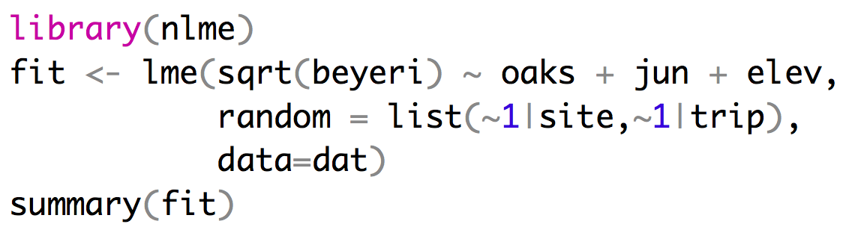
Implementing a mixed effects model
Mixed effect models can be fit using the LME function from the package nlme.
Fixed effects
Random effects
Repeated measures at sites can’t
be treated as independent

Slide 23
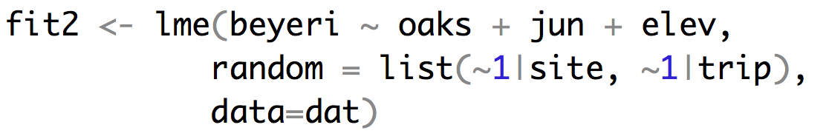
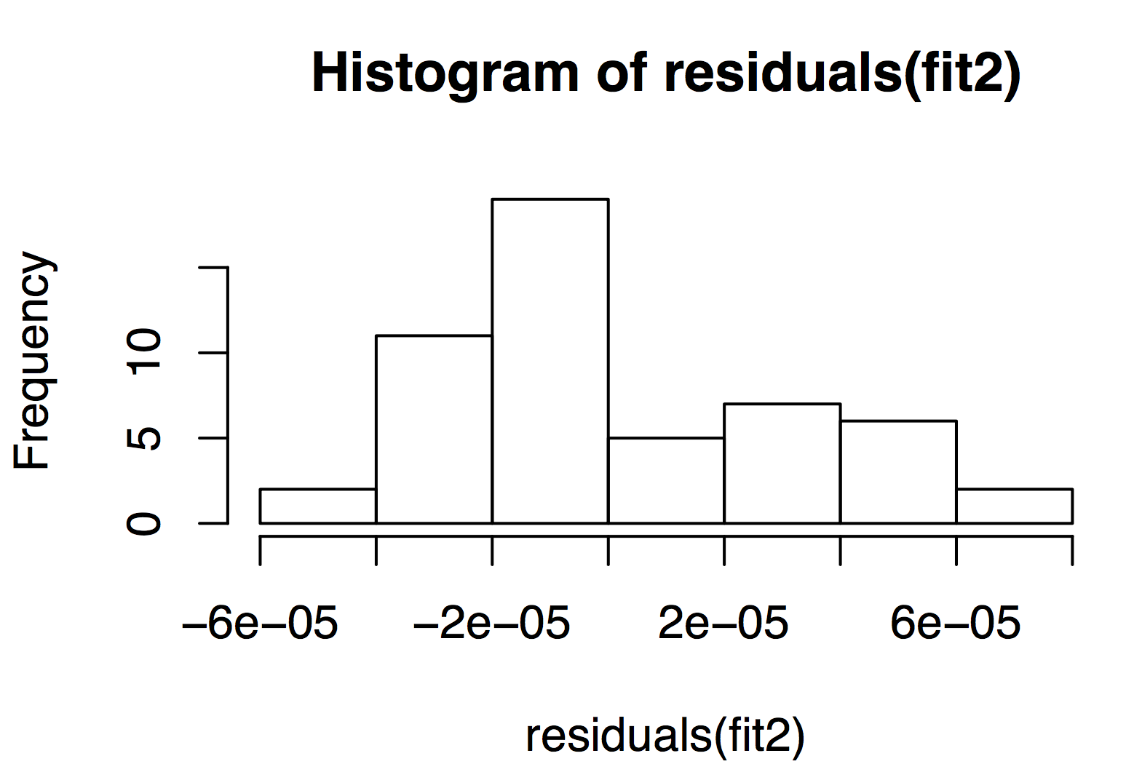
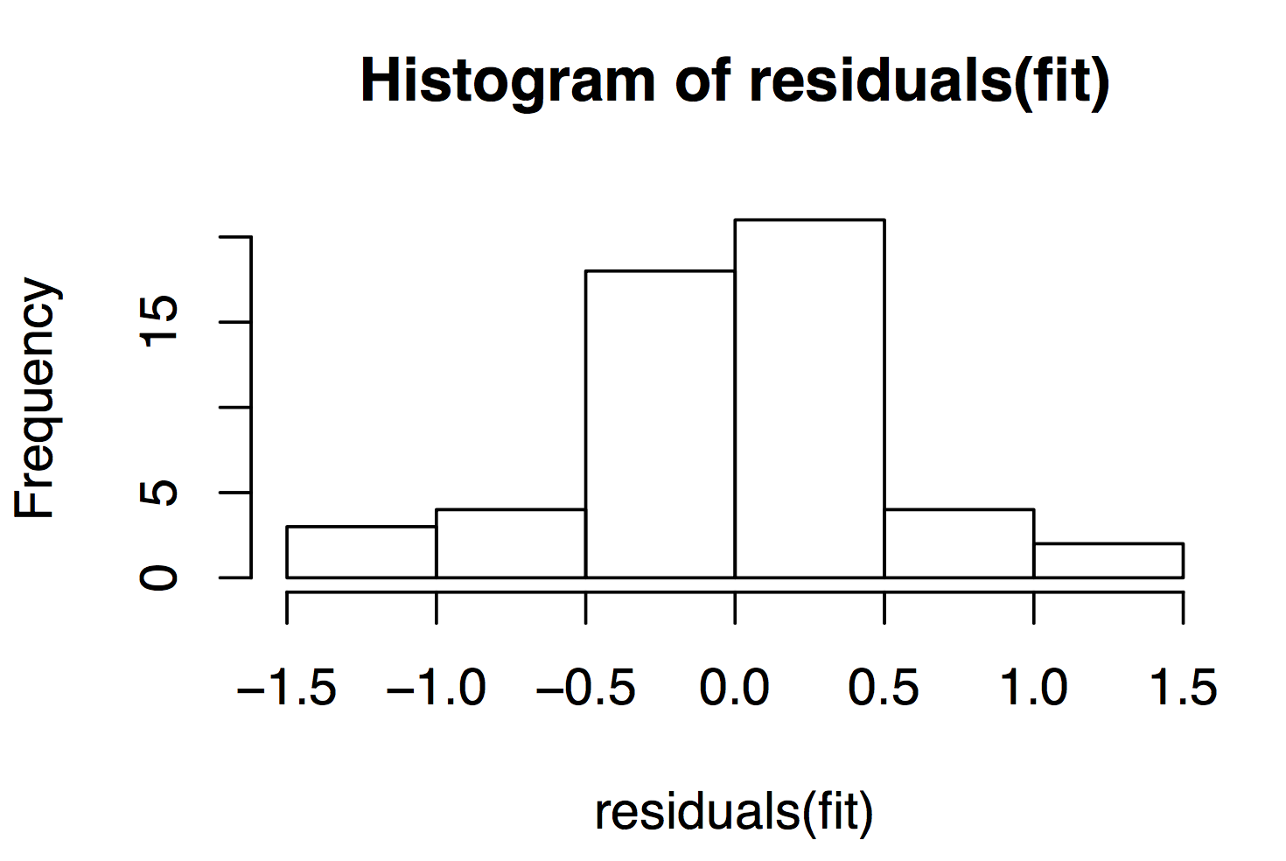
Implementing a mixed effects model

Slide 24
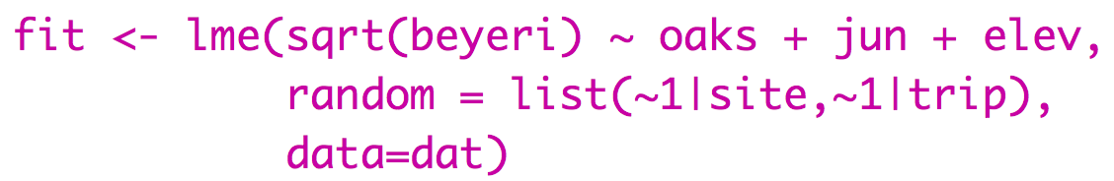
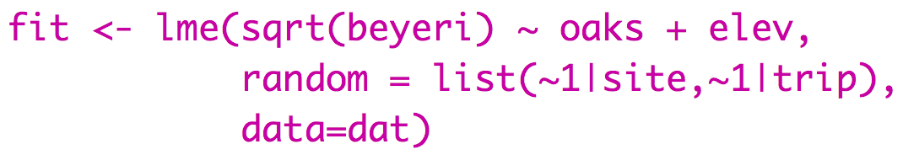
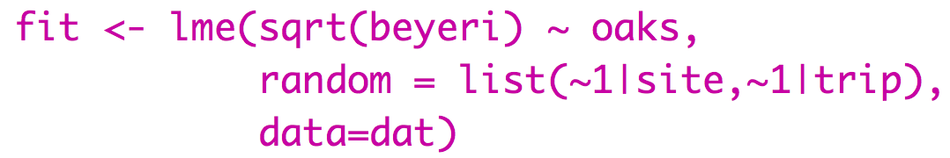
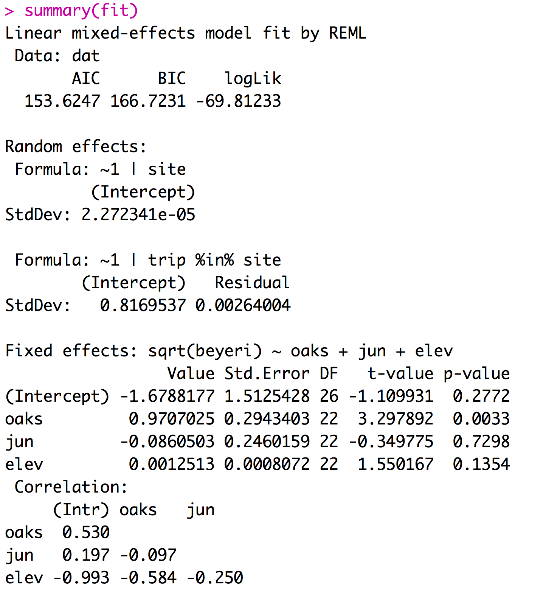
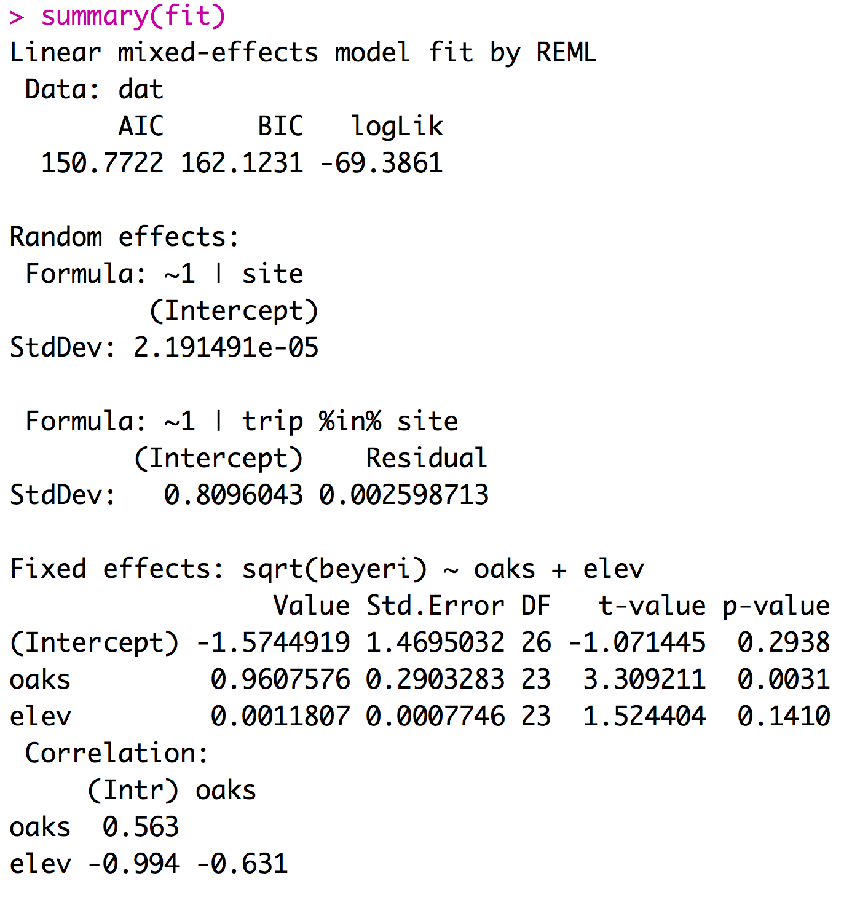
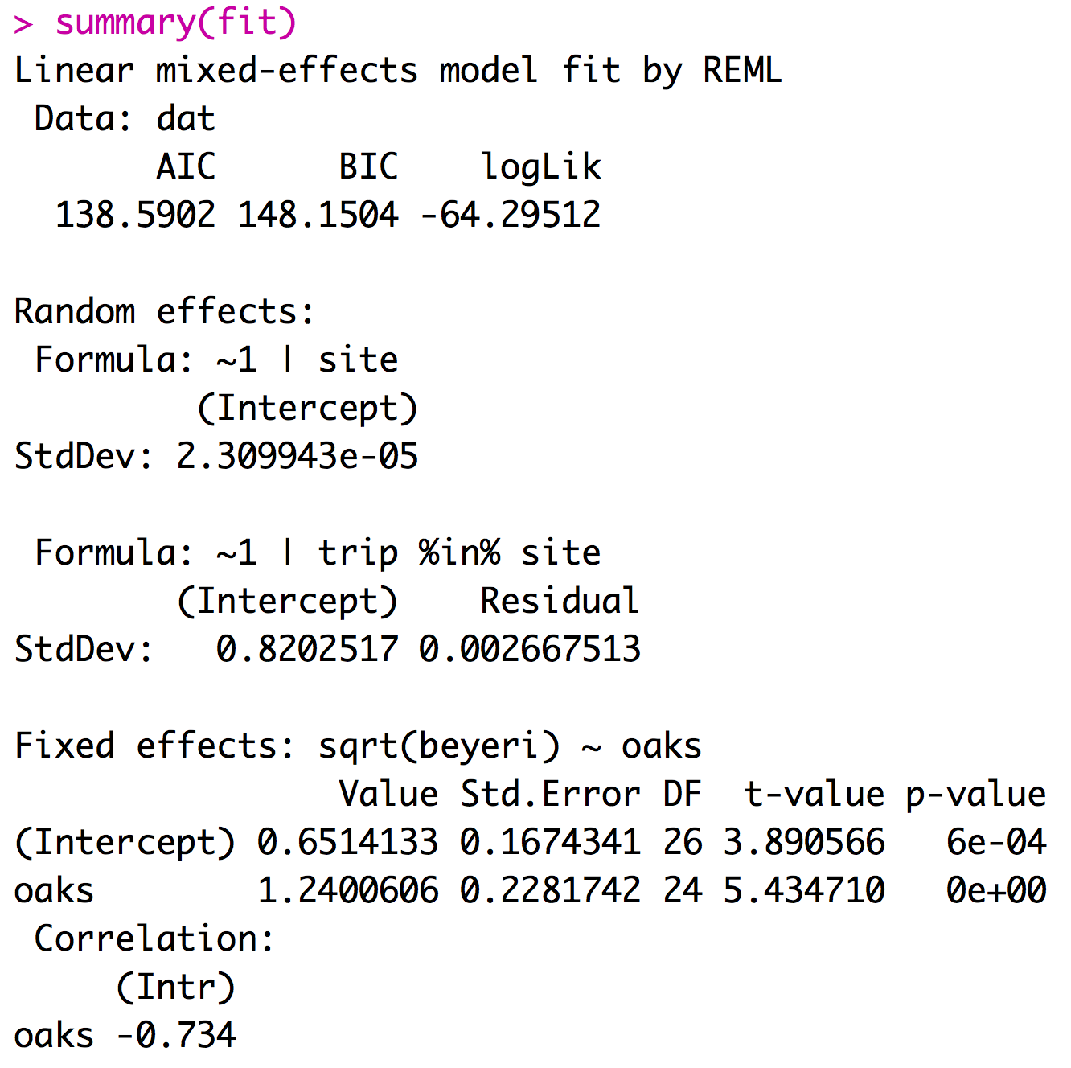
Implementing a mixed effects model
Mixed effect models can be fit using the LME function from the package nlme.
If you report your df with your F-statistic the reviewer will know if you did the right type of model

Slide 25
Considerations for models with random effects
Most software will assume that all factors are fixed unless you specify them as mixed.
Designating factors as random effects takes extra work.
The lm function treats all predictors as fixed effects.
Treating random effects as fixed effects is fundamentally wrong.

Slide 26
4 Types of outliers
1) Obviously erroneously recorded or measured data
3) Extreme data point that impacts statistic of interest.
2) Extreme data point that doesn’t impact statistic of interest but does impact p-value.
4) Extreme data point that creates significance.

Slide 27
Links
MCMCMglmm: Fit mixed models with phylogenetic or pedigree information in a Bayesian framework.
Outlier Package: Apply outlier tests to identify possible outlier datapoints - I don’t recommend this.
If time permits: repeated median regression (Theil-Sen Estimator)
simulate x and y with medium strength relationship and add one outlier
standard regression record Beta
record slope between all pairs and find median slope
repeat standard regression without outlier

